Slide 1
Non-parametric Tests
Prof. Andy Field

Slide 2
Aims
When and why do we use non-parametric tests?
  Wilcoxon rank-sum test
  Wilcoxon signed-rank test
  Kruskal–Wallis test
  Jonckheere–Terpstra test
  Friedman’s ANOVA
Ranking data
Interpretation of results
Reporting results
Calculating an effect size

Slide 3
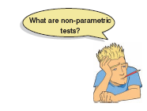
When to Use Nonparametric Tests
Non-parametric tests are used when assumptions of parametric tests are not met.
It is not always possible to correct for problems with the distribution of a data set
  In these cases we have to use non-parametric tests.
  They make fewer assumptions about the type of data on which they can be used.

Slide 4

The Wilcoxon rank-sum test
The non-parametric equivalent of the independent t-test.
Use to test differences between two conditions in which different participants have been used.

Slide 5

Ranking Data
The test works on the principle of ranking the data for each group:
  Lowest score = a rank of 1,
  Next highest score = a rank of 2, and so on.
  Tied ranks are given the same rank: the average of the potential ranks.
For an unequal group size
  The test statistic (Ws) = sum of ranks in the group that contains the least people.
For an equal group size
  Ws = the value of the smaller summed rank.
Add up the ranks for the two groups and take the lowest of these sums to be our test statistic.
The analysis is carried out on the ranks rather than the actual data.

Slide 6
An Example
A neurologist investigated the depressant effects of certain recreational drugs.
  Tested 20 clubbers.
  10 were given an ecstasy tablet to take on a Saturday night.
  10 were allowed to drink only alcohol.
  Levels of depression were measured using the Beck Depression Inventory (BDI) the day after and midweek.
Rank the data ignoring the group to which a person belonged.
  A similar number of high and low ranks in each group suggests depression levels do not differ between the groups.
  A greater number of high ranks in the ecstasy group than the alcohol group suggests the ecstasy group is more depressed than the alcohol group.

Slide 7
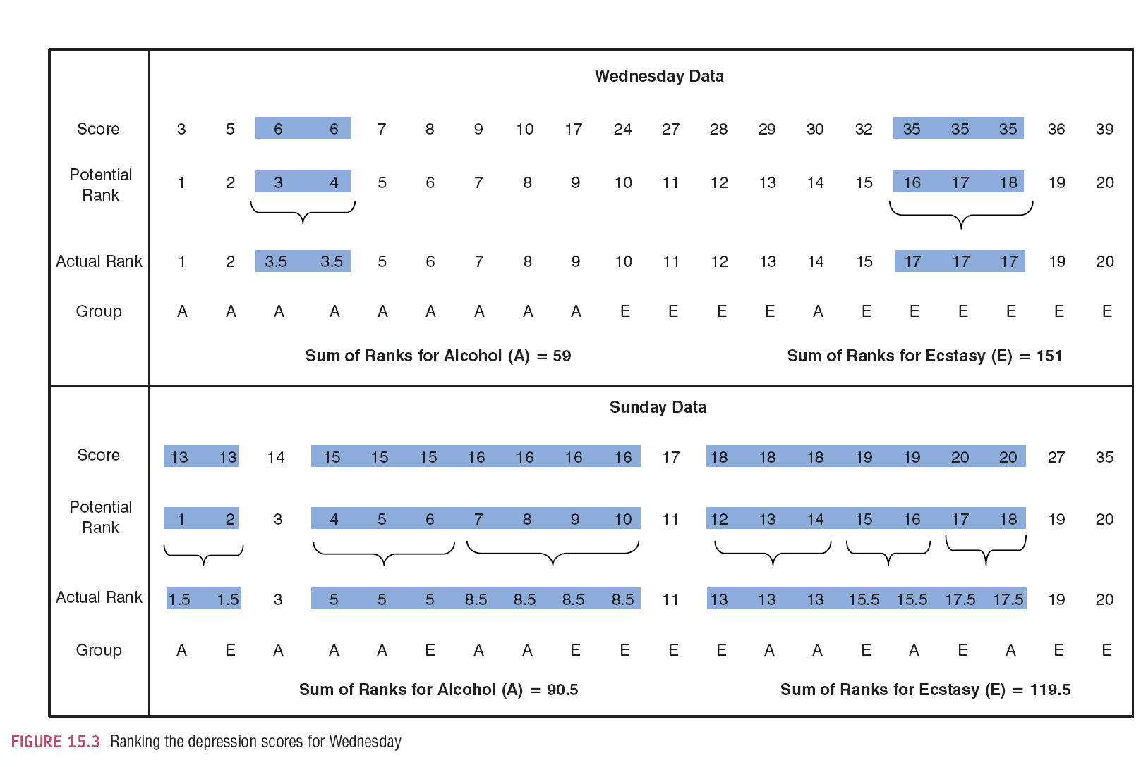
Ranking the Depression Scores for Wednesday and Sunday

Slide 8
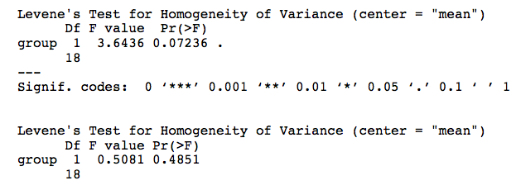
Provisional Analysis

Slide 9
Running the Analysis Using
R Commander
The Nonparametric Tests menu in
R Commander and the dialog box for the Wilcoxon test for independent samples

Slide 10
Running the Analysis Using R
If you have the data for different groups stored in a single column:
  newModel<-wilcox.test(outcome ~ predictor, data = dataFrame, paired = FALSE/TRUE)
However, if you have the data for different groups stored in two columns:
  newModel<-wilcox.test(scores group 1, scores group 2, paired = FALSE/TRUE)

Slide 11
Running the Analysis Using R
To compute a basic Wilcoxon test for our Sunday data we could execute:
  sunModel<-wilcox.test(sundayBDI ~ drug, data = drugData)
  sunModel
For the Wednesday data:
  wedModel<-wilcox.test(wedsBDI ~ drug, data = drugData)
  wedModel

Slide 12
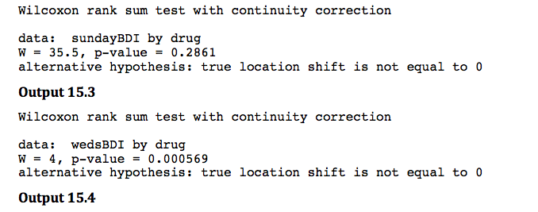
Output from the Wilcoxon Rank-Sum Test

Slide 13
Reporting the Results
Depression levels in ecstasy users (Mdn = 17.50) did not differ significantly from alcohol users (Mdn = 16.00) the day after the drugs were taken, W = 35.5, p = .286. However, by Wednesday, ecstasy users (Mdn = 33.50) were significantly more depressed than alcohol users (Mdn = 7.50), W = 4, p < .001.

Slide 14
Comparing Two Related Conditions: the Wilcoxon Signed-Rank Test
Uses:
  To compare two sets of scores, when these scores come from the same participants.
Imagine the experimenter in the previous example was interested in the change in depression levels for each of the two drugs.
  We still have to use a non-parametric test because the distributions of scores for both drugs were non-normal on one of the two days.

Slide 15
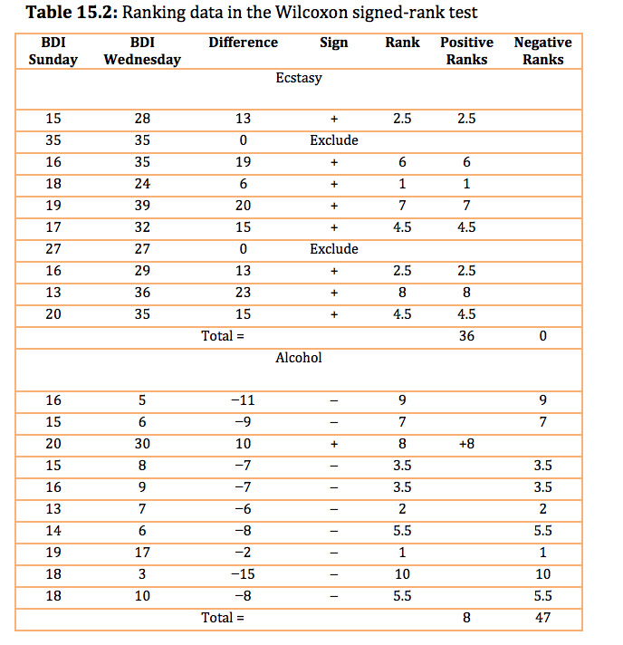
Ranking Data in the Wilcoxon signed-rank test

Slide 16
Running the Analysis Using
R Commander
R Commander menu and dialog box for subset

Slide 17
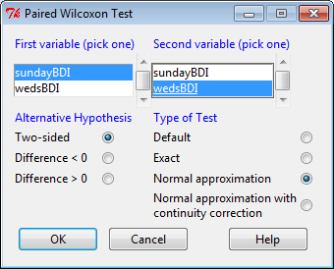
Running the Analysis Using
R Commander
Dialog box for the Wilcoxon signed-rank test

Slide 18
Running the Analysis Using R
We want to run our analysis on the alcohol and ecstasy groups separately; therefore, our first job is to split the dataframe into two using the subset() function:
  alcoholData<-subset(drugData, drug == "Alcohol")
  ecstasyData<-subset(drugData, drug == "Ecstacy")

Slide 19
Running the Analysis Using R
To run the analysis for the alcohol group execute:
  alcoholModel<-wilcox.test(alcoholData$wedsBDI, alcoholData$sundayBDI, paired = TRUE, correct= FALSE)
  alcoholModel
and for the ecstasy group:
  ecstasyModel<-wilcox.test(ecstasyData$wedsBDI, ecstasyData$sundayBDI, paired = TRUE, correct= FALSE)
  ecstasyModel

Slide 20
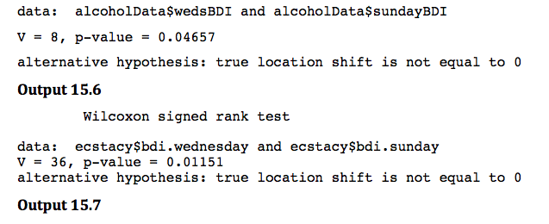
Output

Slide 21
Reporting the results
For ecstasy users, depression levels were significantly higher on Wednesday (Mdn = 33.50) than on Sunday (Mdn = 17.50), p = .047. However, for alcohol users the opposite was true: depression levels were significantly lower on Wednesday (Mdn = 7.50) than on Sunday (Mdn = 16.0), p = .012.

Slide 22
Differences between Several Independent Groups: the Kruskal–Wallis test
The Kruskal–Wallis test (Kruskal & Wallis, 1952) is the non-parametric counterpart of the one-way independent ANOVA.
  If you have data that have violated an assumption then this test can be a useful way around the problem.
The theory for the Kruskal–Wallis test is very similar to that of the Wilcoxon rank-sum test:
  The Kruskal–Wallis test is based on ranked data.
  The sum of ranks for each group is denoted by R_{i} (where i is used to denote the particular group).

Slide 23

Kruskal–Wallis Theory
Once the sum of ranks has been calculated for each group, the test statistic, H, is calculated as:
  R_{i} is the sum of ranks for each group
  N is the total sample size (in this case 80)
  n_{i} is the sample size of a particular group (in this case we have equal sample sizes and they are all 20).

Slide 24
Example
Does eating soya affect your sperm count?
Variables
  Outcome: sperm (millions)
  IV: Number of soya meals per week
    No Soya meals
    1 Soya meal
    4 soya meals
    7 soya meals
Participants
  80 males (20 in each group)

Slide 25
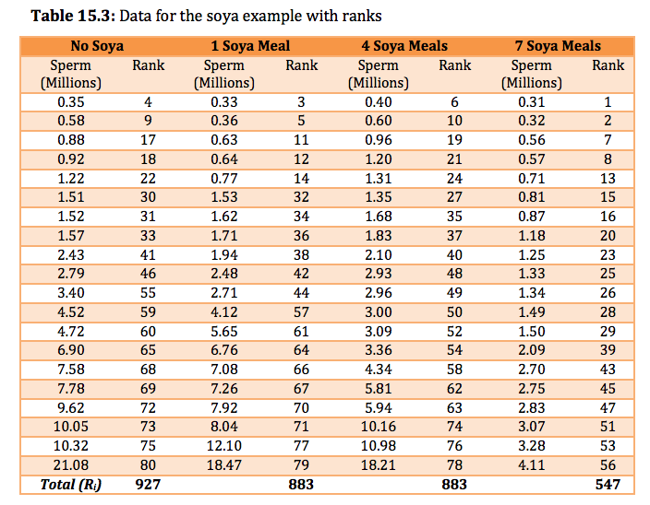
Data for the Soya Example with Ranks

Slide 26
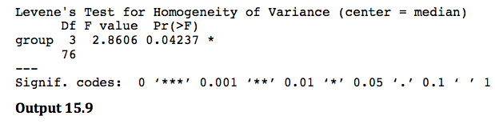
Provisional Analysis
Run some exploratory analyses on the data.

Slide 27
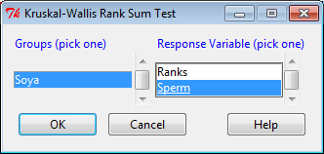
Doing the Kruskal–Wallis Test Using
R Commander

Slide 28
Doing the Kruskal–Wallis Test
Using R
For the current data:
  kruskal.test(Sperm ~ Soya, data = soyaData)
To interpret the Kruskal–Wallis test, it is useful to obtain the mean rank for each group:
  soyaData$Ranks<-rank(soyaData$Sperm)
This command creates a variable Ranks in soyaData dataframe that is the ranks for the variable Sperm. We can then obtain the mean rank for each group:
  by(soyaData$Ranks, soyaData$Soya, mean)

Slide 29
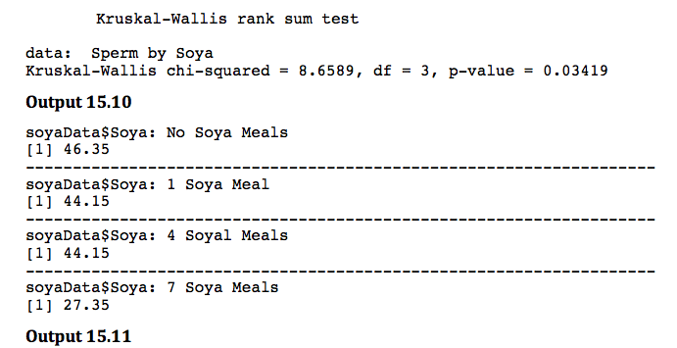
Output from the Kruskal–Wallis test

Slide 30
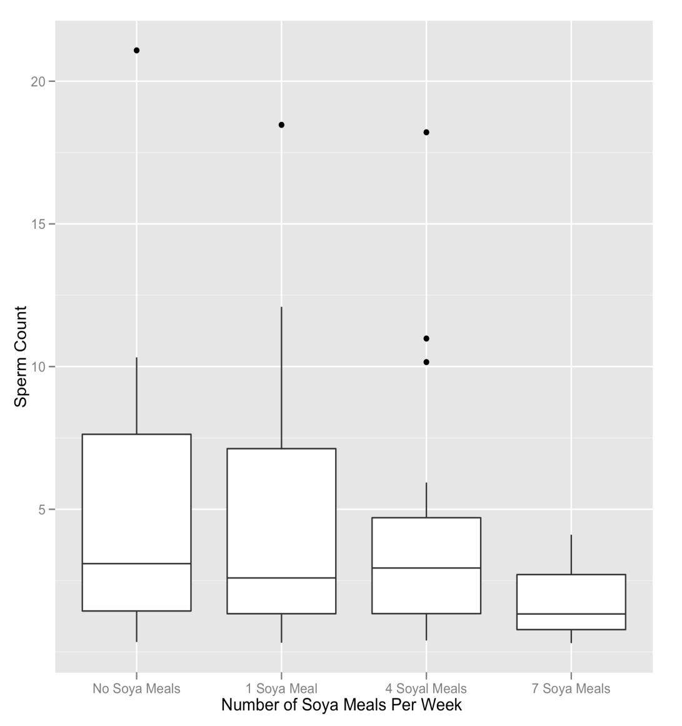
Boxplot for the Sperm Counts of Individuals Eating Different Numbers of Soya Meals per Week

Slide 31
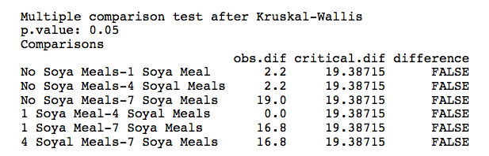
Post Hoc Tests for the Kruskal–Wallis Test
kruskalmc(Sperm ~ Soya, data = soyaData)

Slide 32
Post Hoc Tests for the Kruskal–Wallis Test
One of the problems with comparing every group against all others is that have to be quite strict about accepting a difference as significant otherwise we will inflate the Type I error rate. To reduce this problem we could use more focussed comparisons.
In this example, we have a control group that had no soya meals. As such, a nice succinct set of comparisons would be to compare each group against the control:
  Test 1: one soya meal per week compared to no soya meals
  Test 2: four soya meal per week compared to no soya meals
  Test 3: seven soya meal per week compared to no soya meals
Yo compare each group to the no-soya group (using a two-tailed test) we simply execute:
  kruskalmc(Sperm ~ Soya, data = soyaData, cont = 'two-tailed')

Slide 33
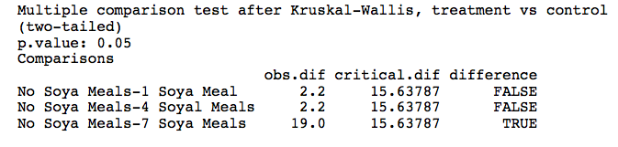
Output

Slide 34
Testing for Trends: the Jonckheere–Terpstra Test
This statistic tests for an ordered pattern to the medians of the groups you’re comparing.
Essentially it does the same thing as the Kruskal–Wallis test but it incorporates information about whether the order of the groups is meaningful.
  Use this test when you expect the groups you’re comparing to produce a meaningful order of medians.
  In the current example we expect that the more soya a person eats, the more their sperm count will go down.

Slide 35
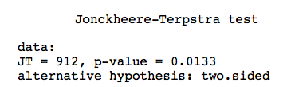
Jonckheere–Terpstra Test Using R
We can conduct a Jonckheere test by executing:
  jonckheere.test(soyaData$Sperm, as.numeric(soyaData$Soya))

Slide 36
Differences between Several Related Groups: Friedman’s ANOVA
Used for testing differences between conditions when:
  there are more than two conditions
  the same participants have been used in all conditions (each case contributes several scores to the data).
If you have violated some assumption of parametric tests then this test can be a useful way around the problem.

Slide 37
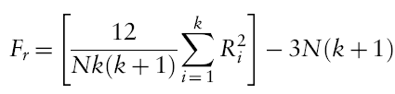
Theory of Friedman’s ANOVA
The theory for Friedman’s ANOVA is much the same as the other tests: it is based on ranked data.
Once the sum of ranks has been calculated for each group, the test statistic, F_{r}, is calculated as:

Slide 38
Example
Does the Andikins diet work?
Variables
  Outcome: weight (kg)
  IV: time since beginning the diet
    Baseline
    1 month
    2 months
Participants
  10 women

Slide 39
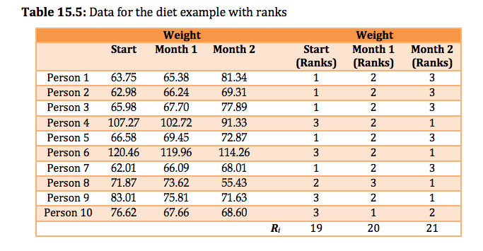

Slide 40
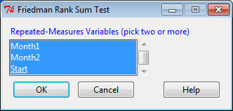
Doing Friedman’s ANOVA Using
R Commander

Slide 41
Friedman’s ANOVA Using R
To run the Friedman test we simply input the name of our dataframe, but within the as.matrix() function, which converts it to a matrix. In this example, we would execute:
  friedman.test(as.matrix(dietData))

Slide 42
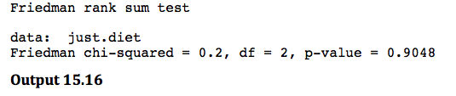
Output from Friedman’s ANOVA

Slide 43
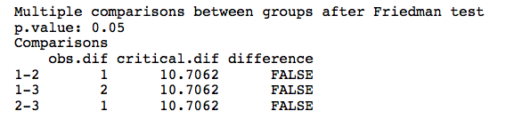
Post Hoc Tests for
Friedman’s ANOVA
For the current data we would execute:
  friedmanmc(as.matrix(dietData))

Slide 44
To Sum Up …
When data violate the assumptions of parametric tests we can sometimes find a non-parametric equivalent
  Usually based on analysing the ranked data
Wilcoxon rank-sum test
  Compares two independent groups of scores
Wilcoxon signed-rank test
  Compares two dependent groups of scores
Kruskal–Wallis test
  Compares more than two independent groups of scores
Friedman’s test
  Compares more than two dependent groups of scores

